Slide 1


Functions and Advanced Transformations

Slide 2

Goal of the learning sections
How to use powerful Methods like groupBy, Join and functions
How use Alter data based by using Lambda
How to save the results back to a database

Slide 3
Intro to Spark functions ?

Slide 4
User Defined Functions
Rows are grouped with the same value of the group or range
Groupby can be extended by aggregation functions
Possible aggregate methods:

Slide 5
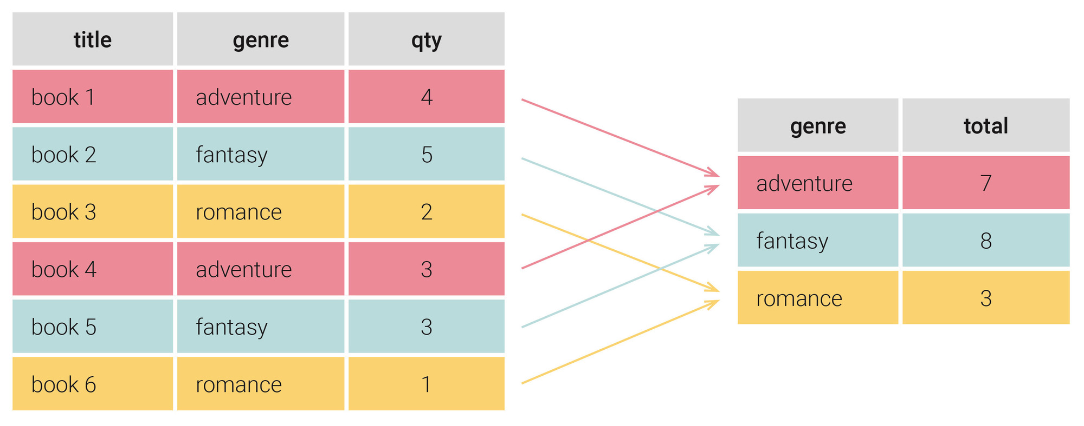
Grouping Values by Attribute
Rows are grouped with the same value of the group or range
Groupby can be extended by aggregation functions
Possible aggregate methods:
Sum, Min, Max, Count
Orderby asc, desc

Slide 6
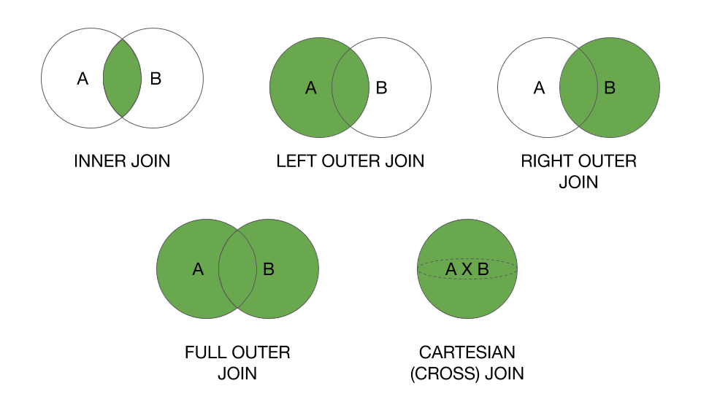
Joining DataFrames
There are several ways to connect two tables
Differentiation between INNER and OUTER JOIN
INNER JOIN (Natural Join) Combination of records that meet join condition
OUTER JOIN Association of records to which there are no correspondences of the values in the two tables
Notes:
Der äußere Verbund muss also immer eingesetzt werden, wenn unbekannte oder fehlende Information im Spiel ist.

Slide 7
Save results to database

